Slide 1

EJE
EXPERIENCES
TRAIN.
CONNECT.
TRAVEL.
An integrated sports experience for athletes, companions and the partners who serve them.
PARTNER PRESENTATION · SEA OTTER EUROPE
Notes:
Content: EJE partner presentation for Sea Otter Europe.
Visuals: EJE About collage supplied by the user.

Slide 2
One event. Five
disconnected decisions.
01
PREPARE
Training and readiness
Athletes often coordinate training, equipment, accommodation, local movement and the companion experience across separate providers.
ARRIVE
02
Equipment and logistics
03
PERFORM
Event-day support
04
SHARE
Every handoff adds friction. EJE connects the full journey around the person.
A companion journey
05
RETURN
The opportunity begins before the start line and continues after the event.
Recovery and continuity
EJE EXPERIENCES
02
Notes:
Content: The sports journey remains fragmented across specialized providers.
Visuals: Editorial typography and EJE brand palette.

Slide 3
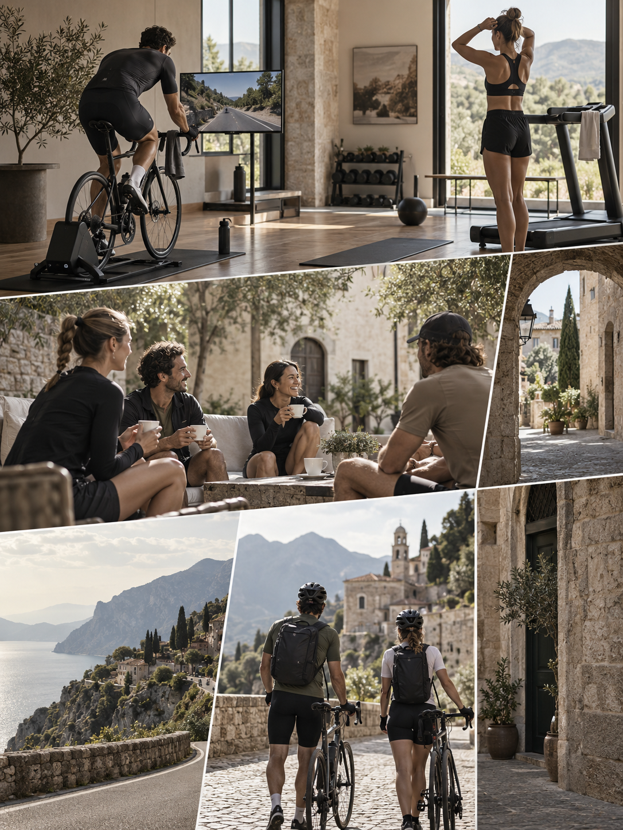
Designed around the way people live sport.
TRAIN
Preparation that fits the athlete and their goals.
CONNECT
Spaces and community that sustain the practice.
TRAVEL
Event, destination and logistics in one itinerary.
We first understand the person. Then we design the experience.
EJE EXPERIENCES
03
Notes:
Content: EJE value proposition and three connected pillars.
Visuals: EJE editorial collage developed for the About concept.

Slide 4
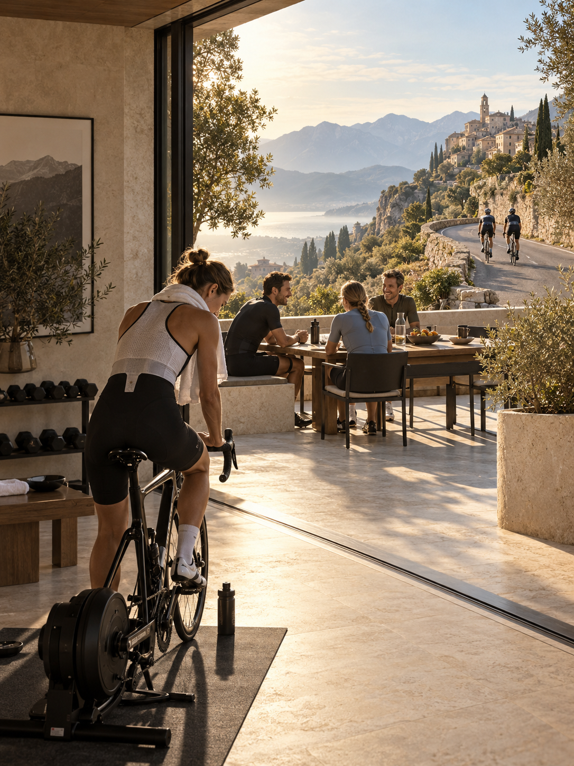
TRAIN
Preparation becomes part of the experience.
A warm, formal and structured training environment with the equipment and connected technology needed to follow progress.
PERSONAL PROFILE
Goals, habits and event demands shape the plan.
PURPOSEFUL SPACE
Every element supports an effective session.
CONNECTED TECHNOLOGY
The athlete can monitor and continue the process.
TRAVEL READINESS
Preparation extends into equipment and departure planning.
EJE EXPERIENCES
04
Notes:
Content: Train proposition for a structured, connected and personal preparation experience.
Visuals: EJE Train Connect Travel concept image.

Slide 5
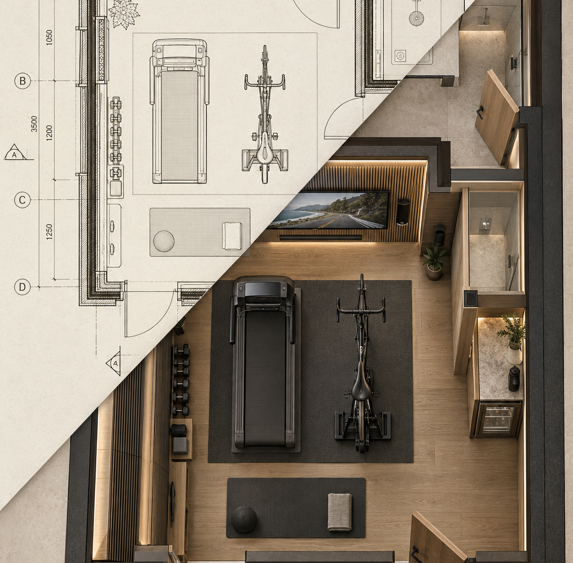
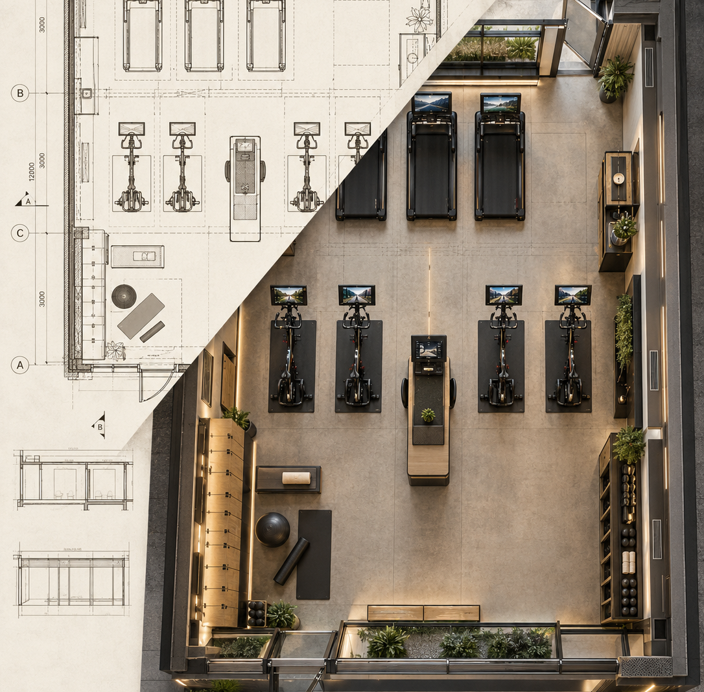
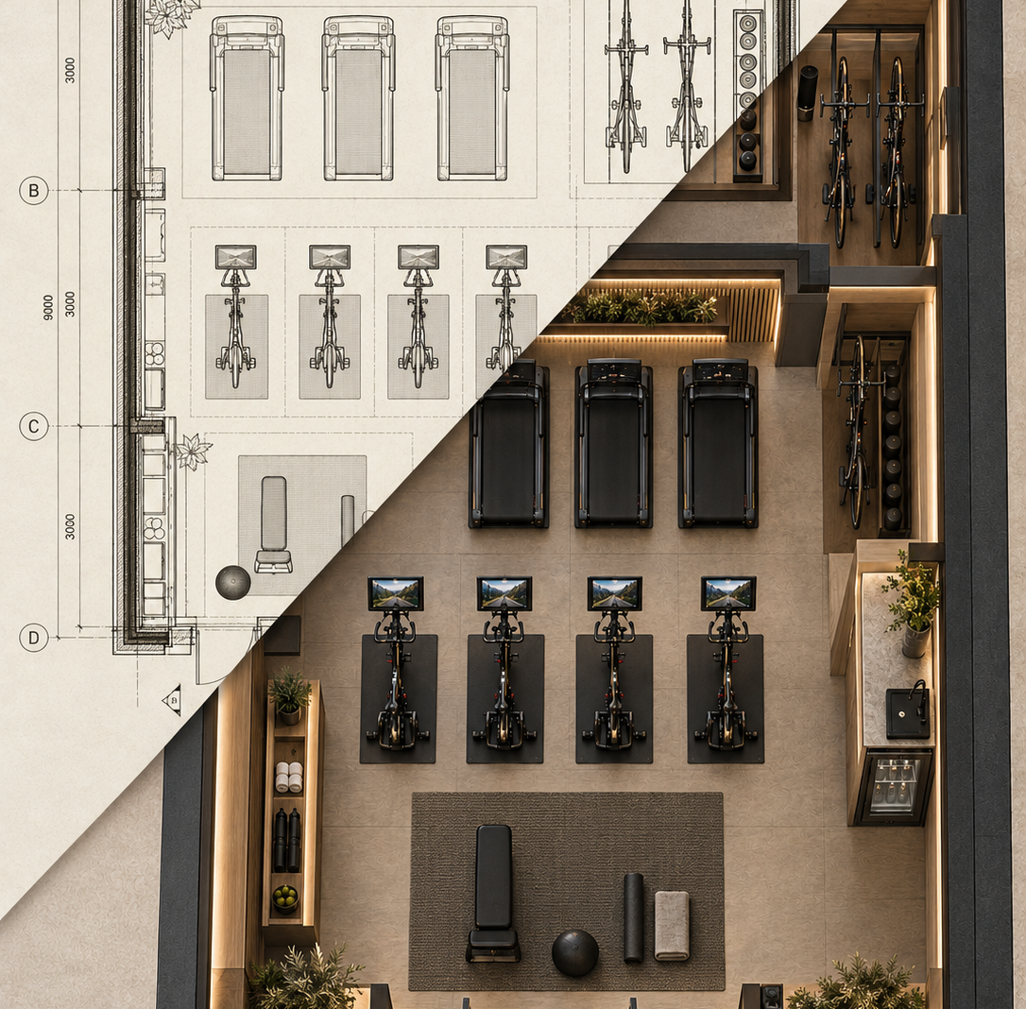
Architecture that supports performance and belonging.
EJE Connect translates the person’s needs into spaces that already feel ready for the sport.
RESIDENTIAL
COMMERCIAL
HOSPITALITY
Personal training integrated into daily life.
A scalable experience for clubs, studios and businesses.
Endurance-ready spaces that extend the stay.
EJE EXPERIENCES
05
Notes:
Content: Residential, Commercial and Hospitality applications of EJE Connect.
Visuals: EJE plan-to-reality architectural images, including the rebuilt Hospitality companion image.

Slide 6

TRAVEL
The event and the destination belong together.
Event access, equipment logistics, boutique stays, local movement, culture and gastronomy come together in one considered itinerary.
01
EXPLORE THE TOURS
02
RIDE THE CLASSICS
03
RIDE EUROPE
04
RUN EUROPE
EJE EXPERIENCES
06
Notes:
Content: Travel proposition and the four experience families.
Visuals: EJE editorial collage developed for the brand concept.

Slide 7
One relationship across the full journey.
The plan remains coherent as the athlete moves from preparation to return.
BEFORE
DURING
AFTER
PROFILE + PREPARATION
ACCESS + SUPPORT
RECOVERY + CONTINUITY
We understand the athlete, the event and the equipment. Training goals and travel choices start from the same brief.
Transfers, event access and local decisions follow one itinerary. The athlete knows who is supporting the journey.
Shared moments, recovery and the next sports goal extend the relationship beyond the finish line.
Confidence grows when every stage feels connected.
EJE EXPERIENCES
07
Notes:
Content: The EJE relationship supports the athlete before, during and after the event.
Visuals: Editorial stage composition in the EJE palette.

Slide 8
THE COMPANION
The companion has a journey of their own.
While the athlete prepares and competes, companions receive a considered program of culture, gastronomy, local discovery and shared moments.
A meaningful experience in parallel.
INDEPENDENT DISCOVERY
SHARED HIGHLIGHTS
LOCAL KNOWLEDGE
EJE EXPERIENCES
08
Notes:
Content: EJE designs a parallel and shared experience for companions.
Visuals: Café and destination crops from the user-approved EJE About collage.

Slide 9
Built for the moments athletes plan their year around.
Curated programs combine a recognizable sporting objective with a deeper sense of place.
GRAND TOURS
Five-stage experiences with boutique stays, local food and optional riding.
THE CLASSICS
Iconic races approached through access, context and cycling culture.
EUROPEAN ROUTES
Destinations selected for the quality of the road and the experience around it.
CITY HALF MARATHONS
Running goals paired with cities worth discovering together.
Small groups or individual departures. Support before, during and after the event.
EJE EXPERIENCES
09
Notes:
Content: EJE travel portfolio spanning Grand Tours, Classics, European routes and half marathons.
Visuals: EJE community and cycling collage.

Slide 10
Where EJE creates the difference.
Our advantage comes from connecting disciplines that the market usually delivers separately.
CAPABILITY
TRAVEL AGENCY
EVENT PACKAGE
SPECIALIST
EJE
Sports motivation shapes the brief
LIMITED
PARTIAL
CORE
CORE
Equipment and event logistics
PARTIAL
CORE
LIMITED
CORE
Companion journey
PARTIAL
LIMITED
LIMITED
CORE
Purpose-built training spaces
LIMITED
LIMITED
CORE
CORE
Continuity before, during and after
LIMITED
PARTIAL
PARTIAL
CORE
EJE begins with the athlete, includes the companion and designs every physical and logistical touchpoint as one experience.
EJE EXPERIENCES
10
Notes:
Content: Qualitative comparison of EJE with common market alternatives. No external benchmark or quantitative claim is implied.
Visuals: Editable text matrix in the EJE visual system.

Slide 11
PARTNERSHIP
HOTELS + RESORTS
Differentiate the stay and build recurring sports programs.
One relationship. Multiple points of value.
DEVELOPERS
Create an amenity designed around residents and daily use.
EJE can create value through curated travel programs, design and integration projects, partner programs and the future community and store.
CLUBS + STUDIOS
Extend the member experience into destination travel.
EVENTS + DESTINATIONS
Improve the journey for athletes and companions.
A platform that can grow across experiences, spaces and recurring relationships.
BRANDS + TECHNOLOGY
Integrate products where they add practical value.
Partnership structures can begin with one program and expand across the EJE platform.
EJE EXPERIENCES
11
Notes:
Content: Partnership pathways and the rationale for investing or associating with EJE.
Visuals: Editorial partnership composition in the EJE palette.

Slide 12
EJE
EXPERIENCES
Let’s build the complete experience.
TRAIN. CONNECT. TRAVEL.
GUILLERMO
Founder & Experience Director
LORENA
Commercial & Guest Experience
WWW.EJEEXPERIENCES.COM
Notes:
Content: Closing invitation and EJE contact roles.
Visuals: User-approved EJE About collage used as a closing background.

